Slide 1
Interpretation of Task-2
Network Intrusion task
common problem in network intrusion is class imbalance.
Used smaller version of dataset which is 10%ge of actual data. As I don’t have enough RAM to process data.
As mentioned in dataset, transformed target variable to target types. Which resulted our data ‘s target variable into 5 different classes.
Most of features have outliers and distribution of each feature follows skewness. Without doing any transformation, DNN able to give better result. I believe , as I handled redundant and constant features, that may helped DNN to perform well.
Then did transformations of each variable to handle outliers and skewness. Performance improved.
Most of best features comes out from Sklearn.SelectKbest features are.
'duration', 'protocol_type', 'flag', 'dst_bytes', 'urgent', 'hot', 'num_failed_logins', 'logged_in', 'root_shell', 'num_file_creations', 'num_shells', 'num_access_files', 'is_guest_login', 'count', 'srv_count', 'serror_rate', 'rerror_rate', 'same_srv_rate', 'diff_srv_rate', 'srv_diff_host_rate', 'dst_host_count', 'dst_host_srv_count', 'dst_host_diff_srv_rate', 'dst_host_same_src_port_rate', 'dst_host_srv_diff_host_rate‘
I think , we should be giving more focus on these variables for Interpriting result.
Did Training of using Deep Neural Network model and when tested with got more than 90%ge accuracy.
But Accuracy is not right metric to conclude. So , Precision and Recall calculated. Which also gives good result.
As mentioned earlier, I have tried smaller sample data. If we will use bigger dataset then , definitely more performance can come. As NN models are data hungry.
So , Technical perspective I think model is fine. But to make it to production, I need to understand more subject knowledge. Then I can decide whether Precision or Recall or F1 score to give more importance.
Made REST Service using Flask. Also, using Azure free account, deployed service.

Slide 2
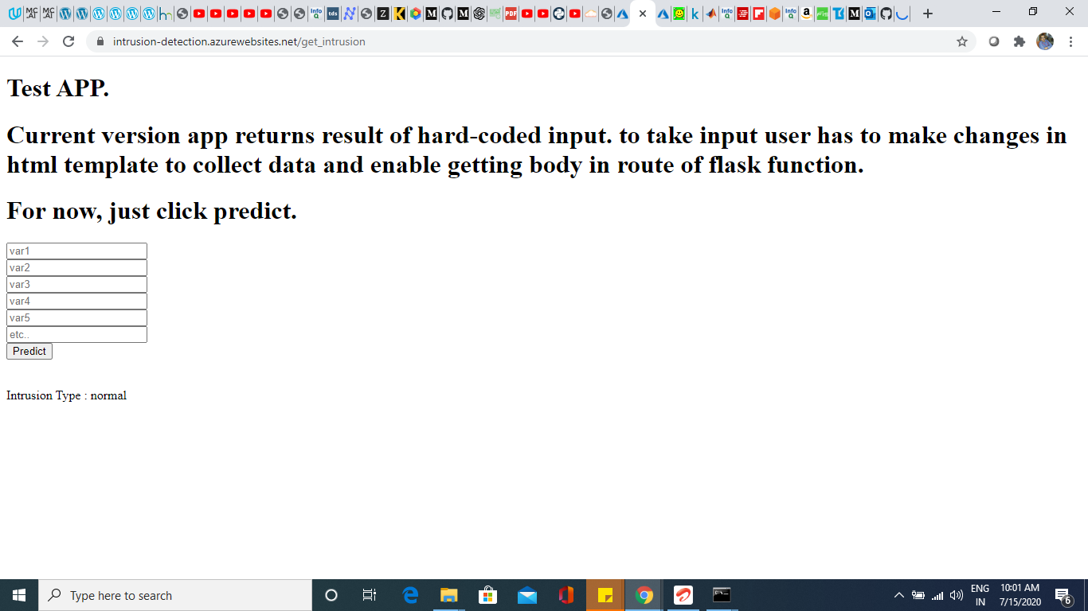
Service Deployed on Azure.

Slide 3
Recommendation of Task-2
Definitely need to collect more data to make atleast ~ balance.
more subject knowledge will help me to clearly define data for later process. For now all I can say is technical details.
I have tried simple Neural Network model for prediction. I’m sure more performance can be improved with complex network , batch processing with batch normalization..etc.
We can try GAN , to generate more adverse features.
Also , we can try seqtoseq model for regenerate same same independent features, which can be also used to generate residuals. And then this residual can be used to understand intrusion and also can be used as independent features for supervised classification. I have intuition , this will give better performance over other.
Finally, ML problems are Iterative process.

Slide 4
Interpretation of Task-1
For English
Proper explanation given for each process and line of code.
Short form of text always been challenging. Specifically when text doesn’t follow grammatical structures. But that’s open problem. So what I can do most, is identifying desired data using rule-based parsers. So I did.
Phrases came good. What I mean by that : I visited sample data and tried to verify phrases whether they are meaningful or not.
Most importantly I tried to segregate hashtags, usertags and remaining text(excluding hashtag and usertag).
For Japanese
NOTE: Completely different procedure followed for Japanese text. As tokenization of each language are different.
To validate result, I tried Google Translate for Japanese to English and vice versa.

Slide 5
Recommendation of Task-1
Technically able to interpret result. But I believe for every problem, context or subject knowledge does help in giving more interpretation of result and gives hope for work.
ML models like Entity recognition helps much. So, in future, will recommend to use POS-tags, NER.

